Slide 1
Reflection
WE ARE THE BEST!!!!

Slide 2
1. STABILITY comes FIRST!
Tried many things to make it look better?
Note: The text below is intentionally made small to put pressure on you guys☺
Both bumping beacons and using LEDs /Using a fancier support of LEDs/Changing the chasis so that we can use two reflectance sensors/Try to make it claim beacons at the same time of moving faster(We Imagined our robot to be a fierce monster!!!

Slide 3

BUT:
Too many things failed
FANCY CHASIS for one more reflectance sensor?
SADLY, sensors failed the chasis
TWO robots?
Parts kept BREAKING APART!!!
FASTER speed?
CANNOT CLAIM BEACONS!!!
Moderate speed is the best.

Slide 4
SO?
We used:
ONLY ONE reflectance sensor on our fancy chasis.
ONLY ONE robot, and the other one sacrificed.
Codes shown before to make MODERATE SPEED.

Slide 5
2. SIMPLENESS makes success.
More than our expectation:
WE GOT INTO THE FINAL ROUND!!!!
BUT:(((

Slide 6
Reasons
Too many wires(when making more LEDs)
In the future:
try to look for the simplest circuit and solder less.

Slide 7
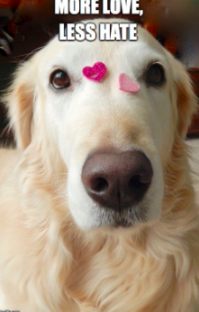
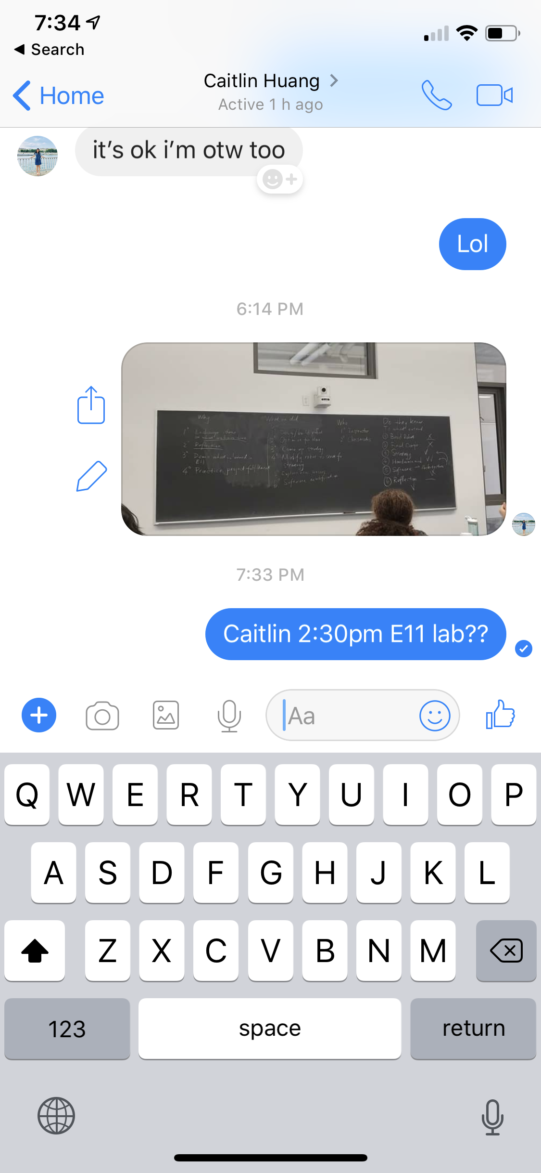
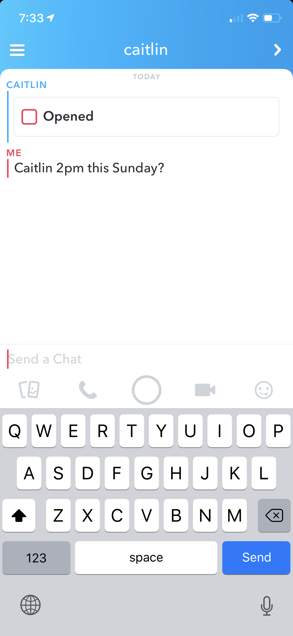
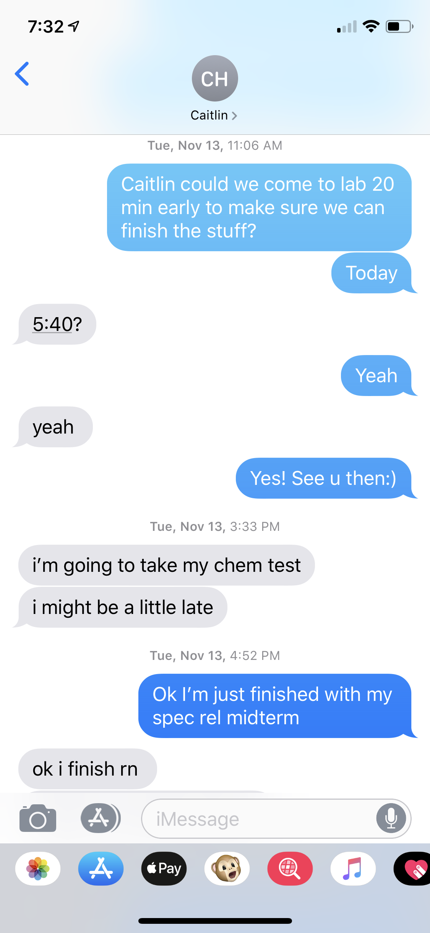
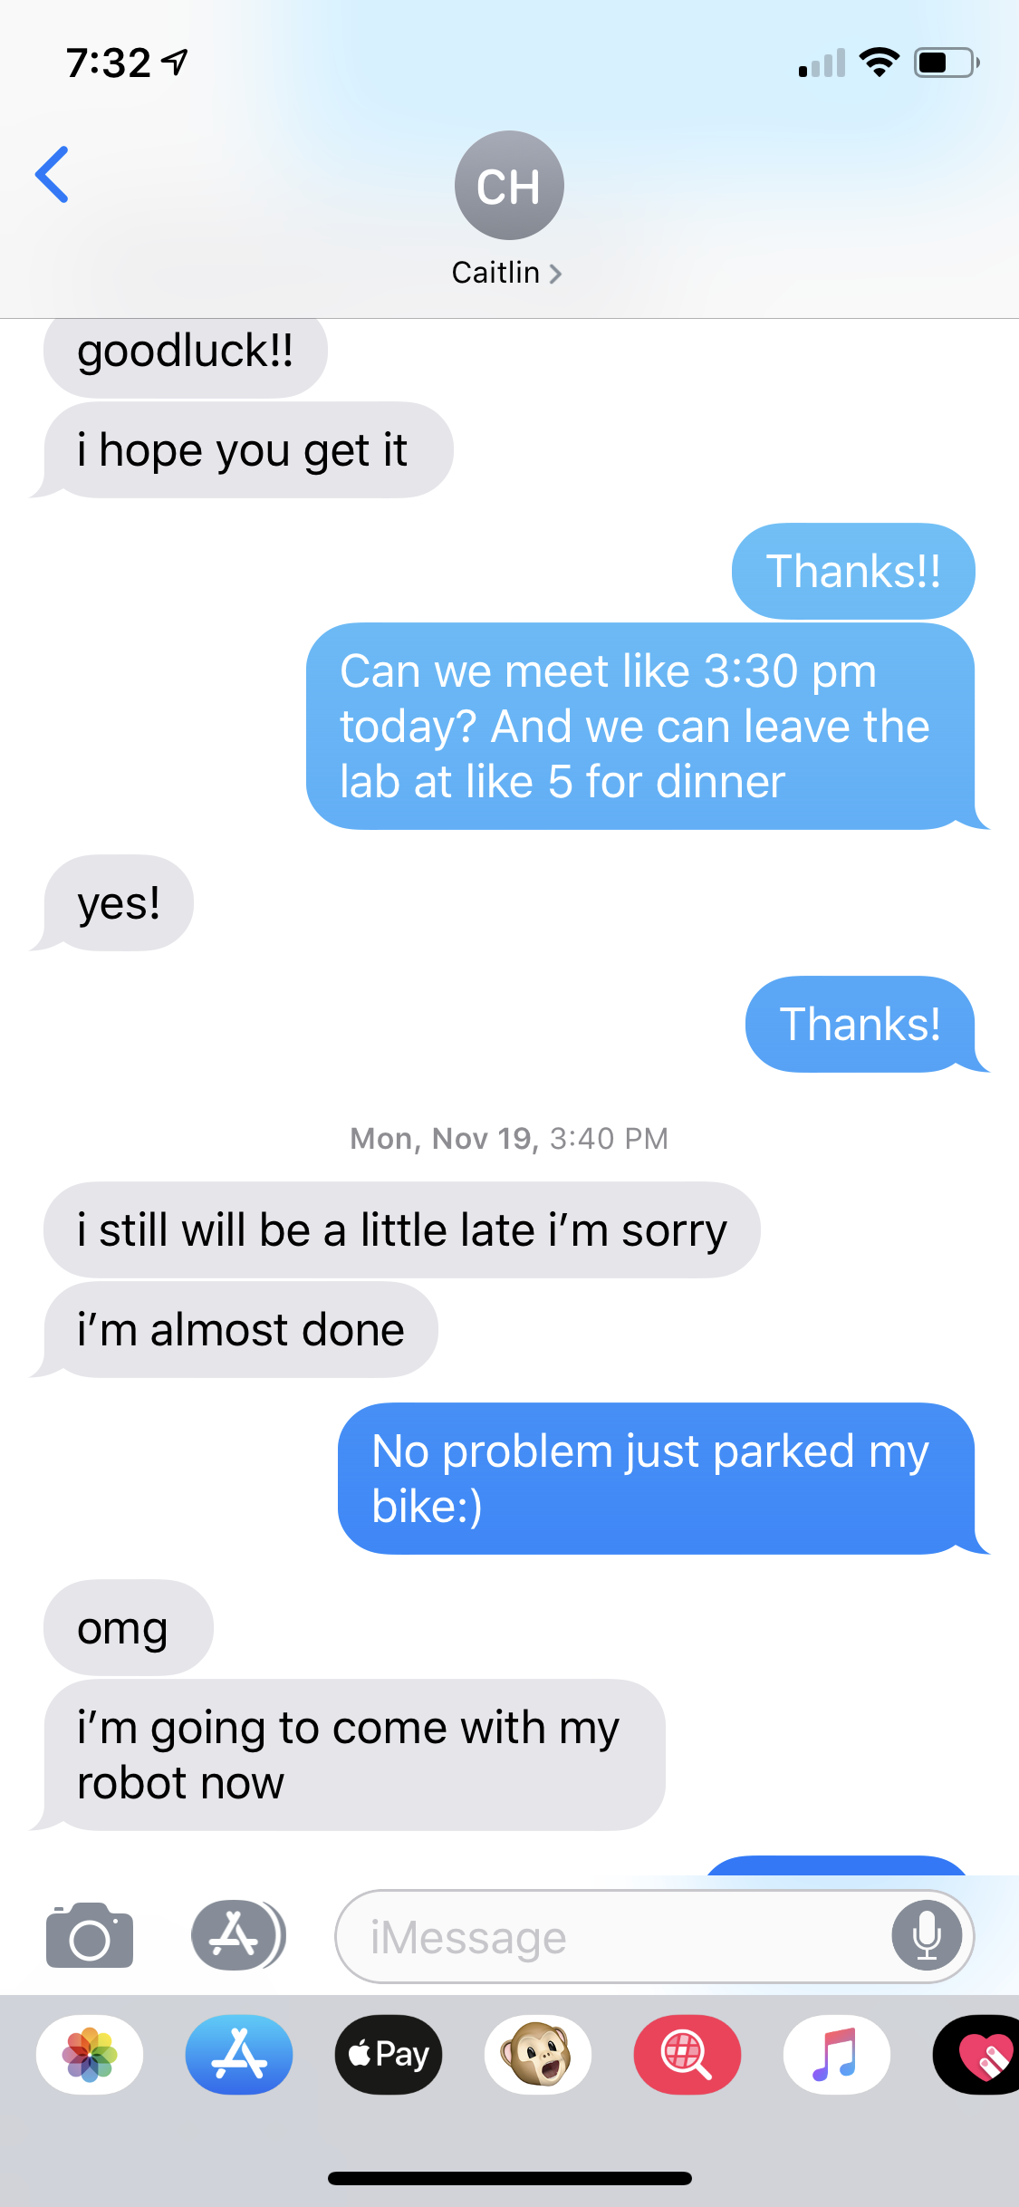
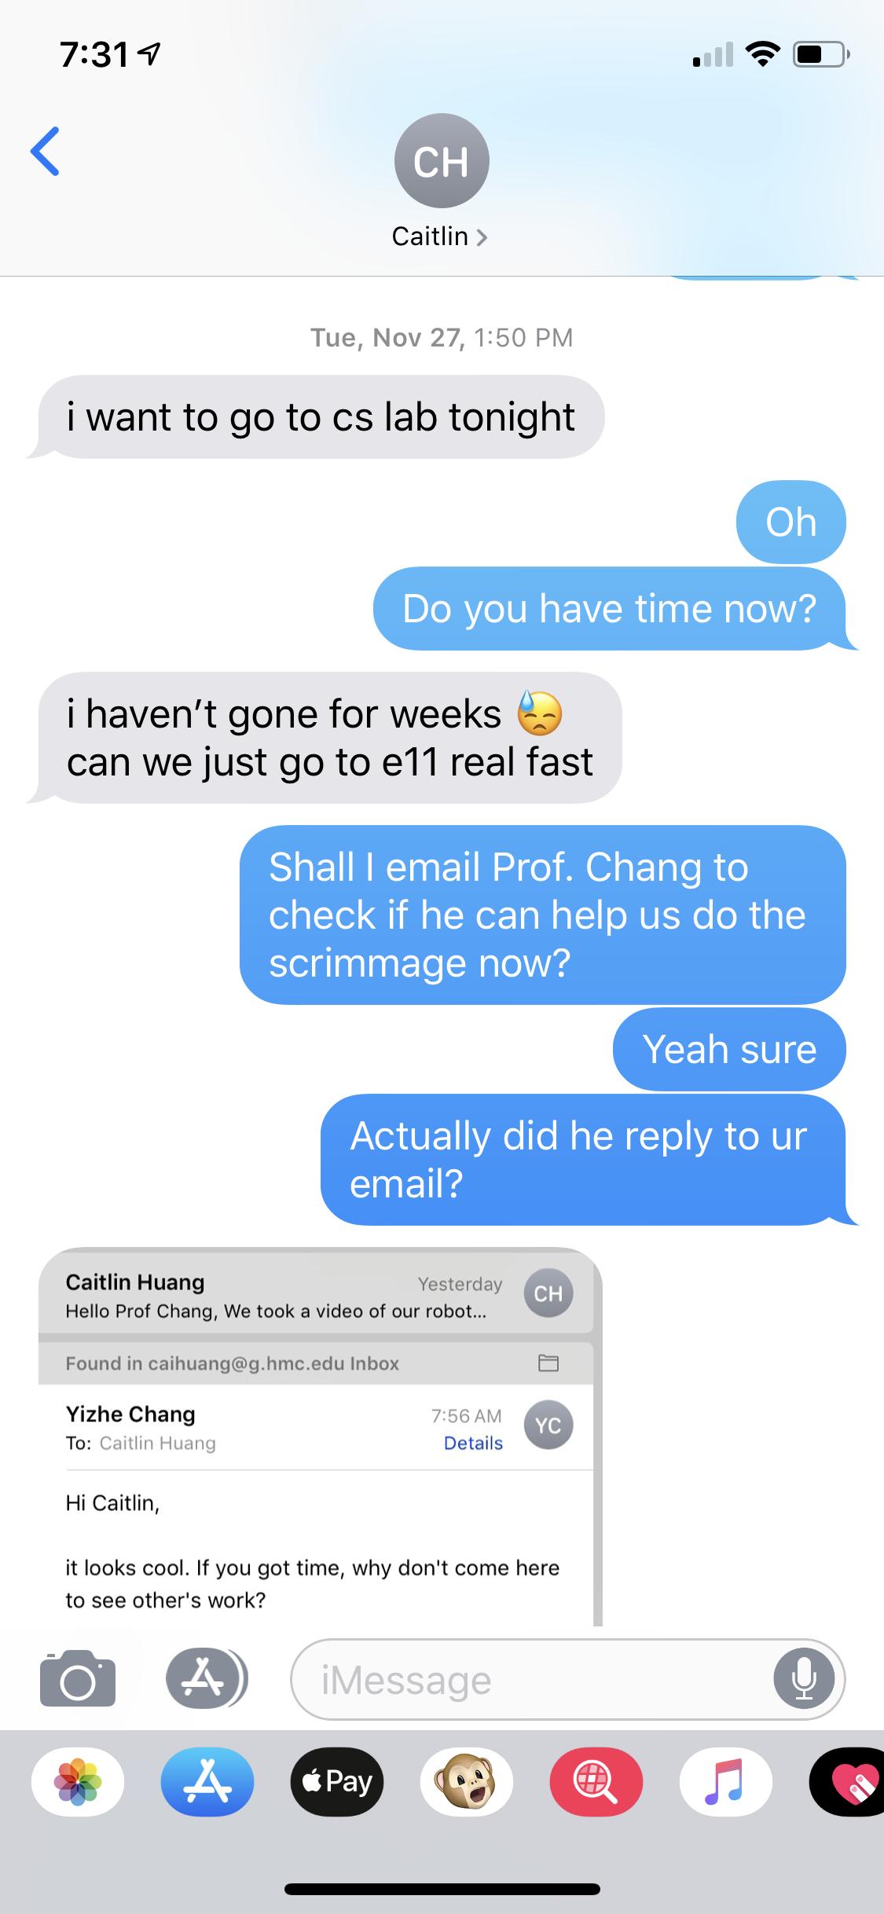
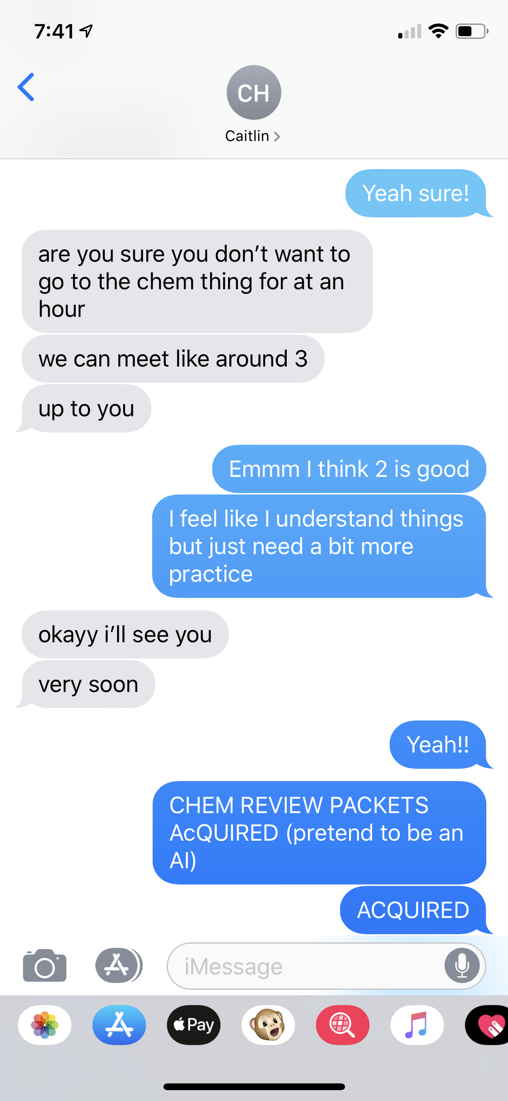
3. WORK HARD and COOPERATE!
Text/
Send message to/
Snapchat your partner/
To force her to spend the whole Sunday afternoon in SADNESS AND TEARS

Slide 8
Take-away Message
1. Stability comes first
2. Simpleness makes success
3. Work hard and cooperate

